Slide 1

Audio Detection in Online Proctored Exam
Intern : Swapnil Jadhav
Project Manager: Deepak Mali

Slide 2
Flowchart
Sound Detected
Start audio recording
Google Speech to Text API
Stopwords Removed and compared
Text from Question and Answer paper
Compared with
Noise Warning
Not detected
Common Words Detectection
detected
CheatingWarning
Audio File deleted
Words Displayed to invigilator
Audio File saved

Slide 3

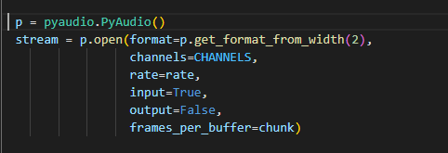
1. PyAudio
PyAudio provides Python bindings for PortAudio v19, the cross-platform audio I/O library. With PyAudio, you can easily use Python to play and record audio on a variety of platforms, such as GNU/Linux, Microsoft Windows, and Apple macOS.

Slide 4

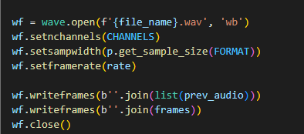
2. Wave
The wave module provides a convenient interface to the WAV sound format.

Slide 5

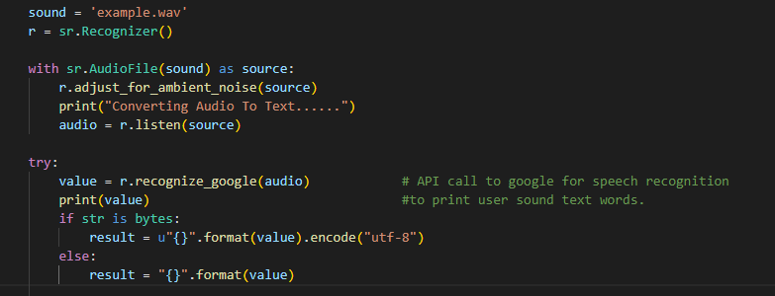
3. Speech Recognition
From speech_recognition , we used a class called Recognizer. This is the class that will help us to convert audio files into text. Speech Recognition has a built-in function to make it work with many of the APIs out there.
We use the Google Recognizer function, which is recognize_google(). It’s free and doesn’t require an API key to use.

Slide 6
Text Cleaning
Raw Text
Hello. My name is Swapnil.
Tokenize
Hello, My , name , is , Swapnil
Remove
Stop Words
Swapnil
Cleaned Text
Swapnil

Slide 7
Tokenizing
Tokenization is essentially splitting a phrase, sentence, paragraph, or an entire text document into smaller units, such as individual words or terms. Each of these smaller units are called tokens.
Removing Stop Words
A stop word is a commonly used word (such as “the”, “a”, “an”, “in”) that a search engine has been programmed to ignore, both when indexing entries for searching and when retrieving them as the result of a search.

Slide 8
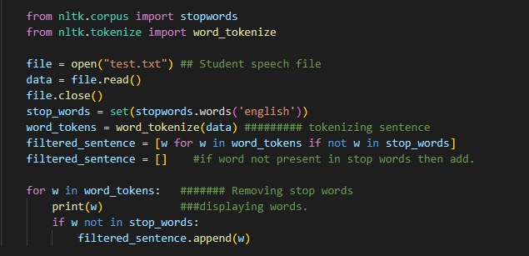

Slide 9
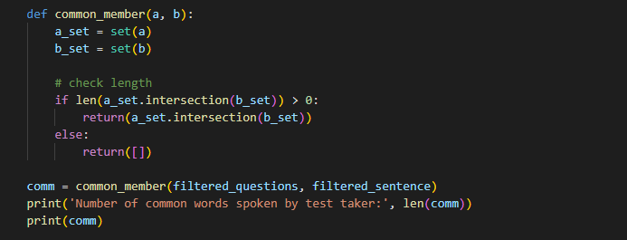
5. Detecting common words
The filtered words from both question paper and user voice are stored in different lists which are compared with each other. If common words are found then its return by function.

Slide 10
Advantages
Speaking with someone else while exam, can be avoided.
Proof for future reference and Invigilator.
Automatic process. No need to check for recording.

Slide 11
Disadvantages
Candidate can cover microphone with something.

Slide 12
Solution
At the start of the exam, We can ask for candidates name and give instructions to him by his name.
This will ensure that his microphone is not covered by anything and ON. So, we can minimize the malpractice.

Slide 13
Any Doubts or Suggestion ?

Slide 14
Thank You !

